Slide 1






EMAIL MARKETING

Slide 2
Introduction to Email Marketing
Email marketing is a direct and effective way to connect with your audience, promote your products, and build long-term customer relationships. By sending personalized messages straight to the inbox, brands can share updates, offers, and valuable content with people who genuinely want to hear from them. It’s affordable, measurable, and one of the most reliable digital marketing strategies for driving engagement and sales.

Slide 3
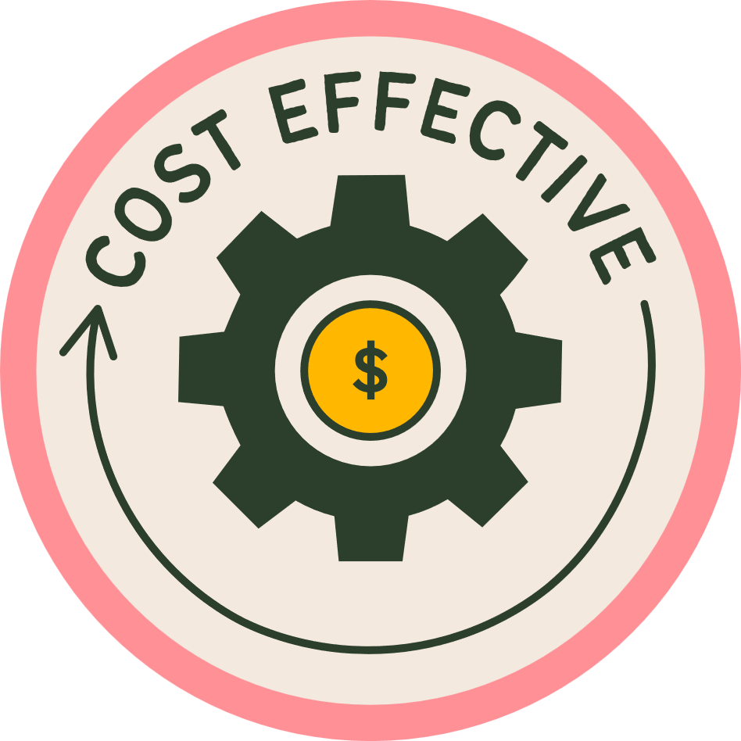




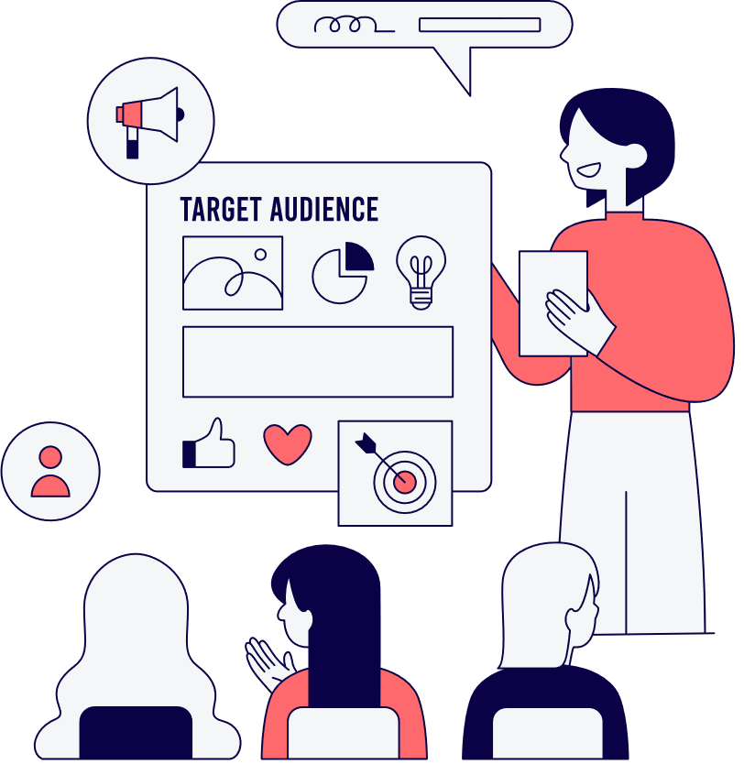
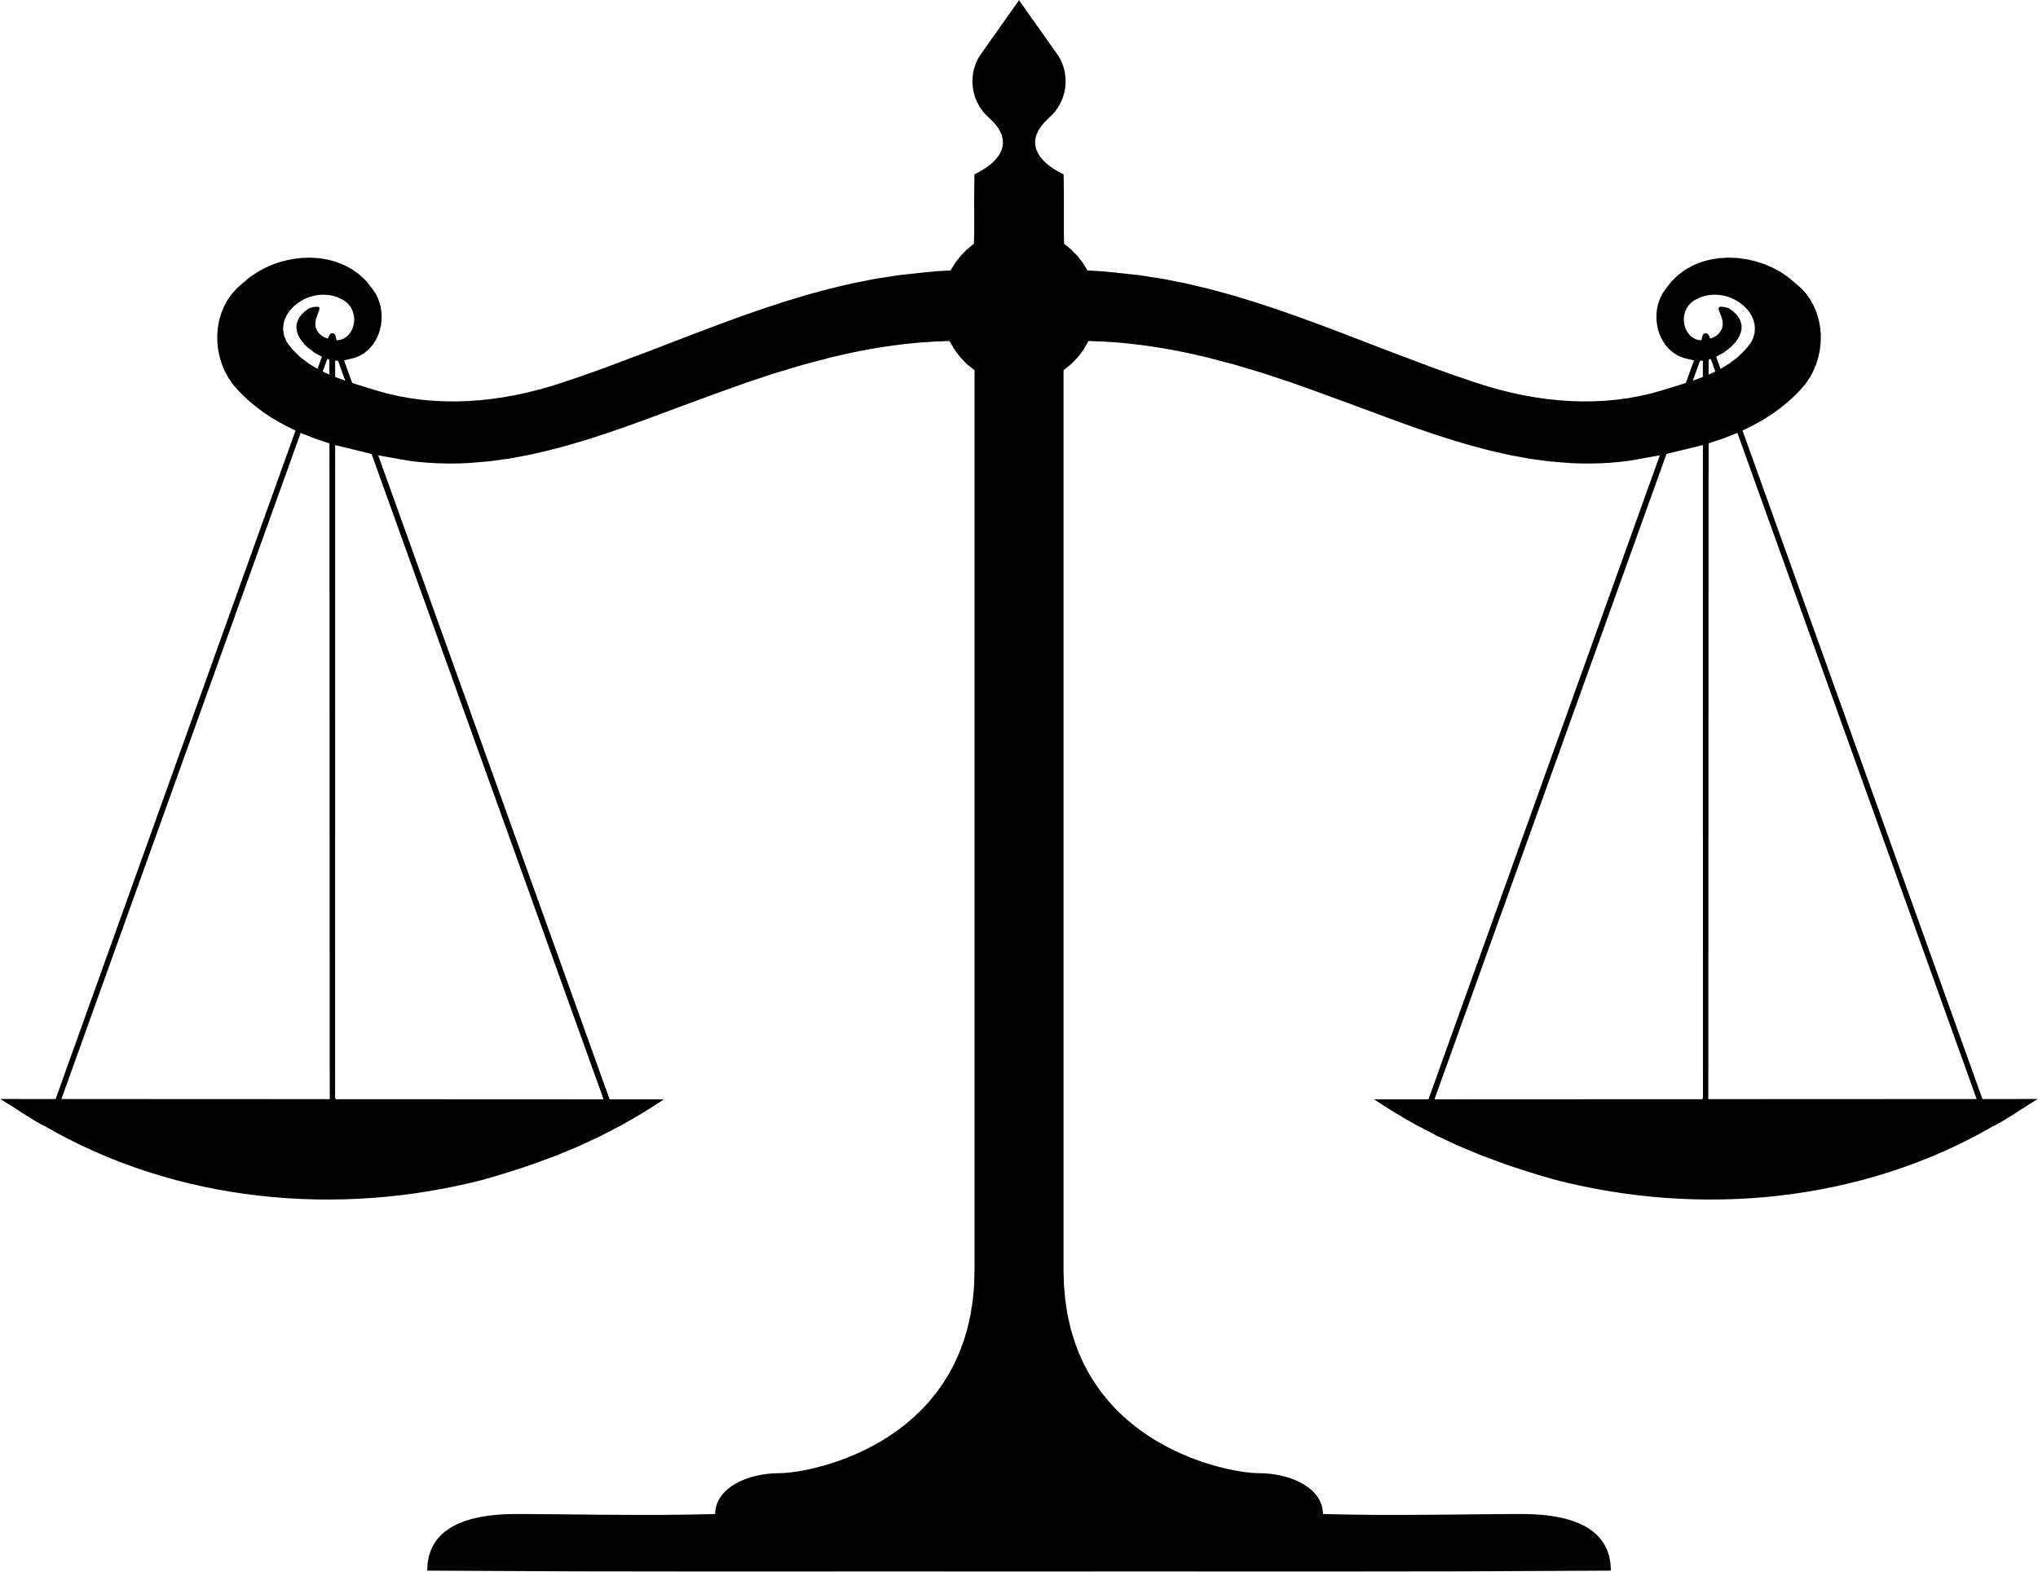

Cost-effective with minimal investment
Measurable results (opens, clicks, conversions)
Advantages of
EMAIL MARKETING
Direct communication with your audience
Easy to automate and scale
Highly targeted and personalized messaging

Slide 4




types of email marketing
Newsletter Emails
Promotional Emails
Welcome Emails
Transactional Emails
Drip/Automated Emails
Re-engagement Emails

Slide 5

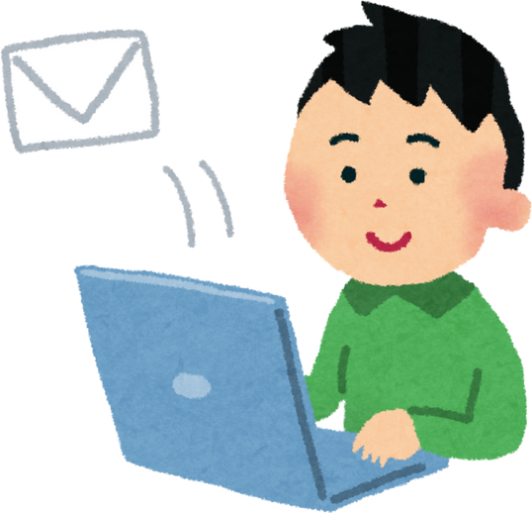

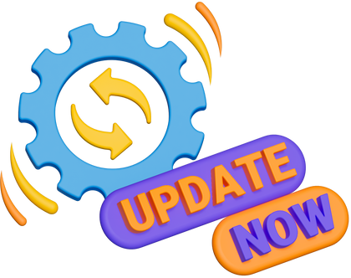
Email Marketing Strategy
Build and segment your email list
Use automation and analytics
CREATE VALUABLE, ENGAGING CONTENT
to send relevant messages to the right audience.
with clear subject lines and strong CTAs.
to send timely emails and optimize performance based on results.

Slide 6
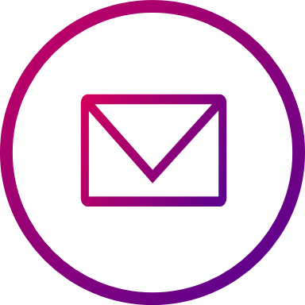




Two-way
Crafting
Interaction:
Leveraging
Harnessing
Compelling Content:
Mailchimp
Data Analytics:
Social Platform:
Brevo
Klaviyo
SendPulse
Email marketing tools

Slide 7


Email Marketing Best Practices
  Build a clean, permission-based email list – Only email people who opted in.
  Write compelling subject lines – Short, clear, and attention-grabbing.
  Personalize your emails – Use names, preferences, and behavior-based content.
  Segment your audience – Send relevant emails to different groups.
  Keep your message clear and concise – Avoid long, cluttered emails.
  Add a strong, clear CTA (Call to Action) – Tell readers what to do next.
  Use mobile-friendly designs – Most people read emails on phones.
  Maintain consistent sending frequency – Don’t spam; stay steady.
  Test before sending – Check links, design, spelling, and layout.
  A/B test subject lines and content – Improve performance with experiments.
  Track key metrics – Open rate, click-through rate, conversions, unsubscribes.
  Follow email laws – Include unsubscribe links and correct sender info.

Slide 8
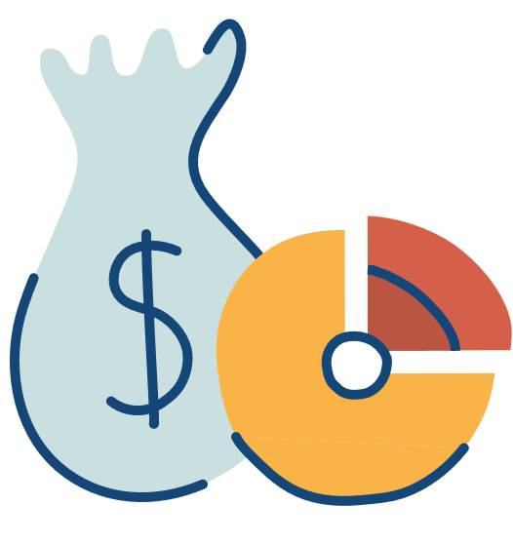
  Cost-effective – Low cost compared to ads or traditional marketing.
  Direct communication – Reach customers straight in their inbox.
  Highly targeted – Send personalized messages to specific customer groups.
  Increases sales & conversions – Promote offers, launches, and upsells effectively.
  Builds customer relationships – Stay connected through updates and valuable content.
  Boosts website traffic – Drive users to blogs, product pages, and landing pages.
  Easy to automate – Save time with welcome series, follow-ups, and reminders.
  Measurable results – Track opens, clicks, and conversions to improve strategy.
  Strengthens brand loyalty – Regular communication builds trust and recall.
  Works for all business sizes – Small or big, any business can benefit.
Benefits of Email Marketing for Businesses

Slide 9

Email marketing remains one of the most effective and reliable digital
marketing strategies for businesses of all sizes. With its ability to deliver personalized messages, nurture customer relationships, and drive consistent sales at a low cost, email continues to offer unmatched value. By using the right tools, segmentation, automation, and engaging content, businesses can build stronger connections with their audience and achieve long-term growth.
CONCLUSION

Slide 10

THANKYOU

